Slide 1
Dependency Parsing
CSE431
Natural Language Processing-1
Member 1:
Name : Ishrat Tasnim Awishi
ID: 20301031
Section: 2
Member 2:
Name : Niloy Farhan
ID: 20101118
Section: 2

Slide 2
What is Dependency Parsing
It is used to figure out how all the sentence related to each other.
It is the process of analyzing the grammatical structure of a sentence based on dependencies between the words in a sentence.

Slide 3
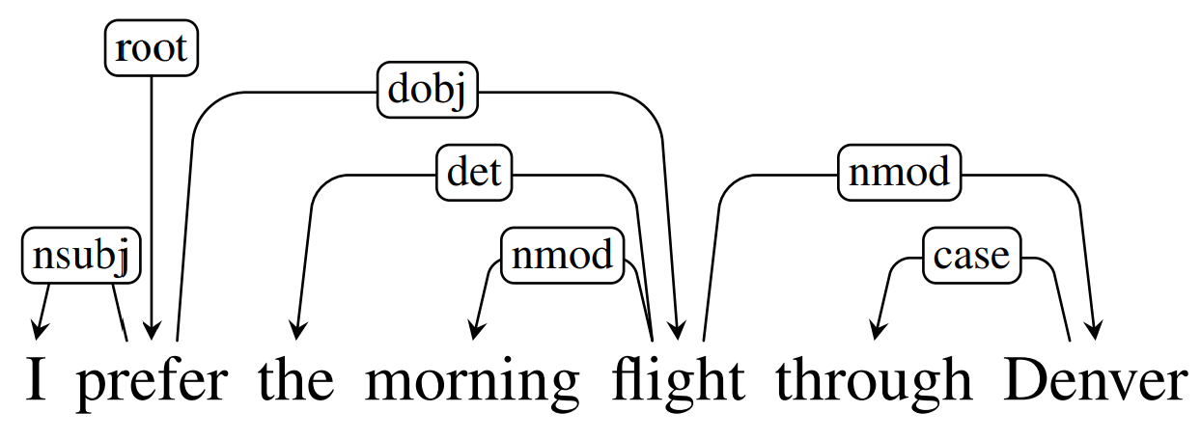
Example of Dependency Parsing
Notes:
Figure 14.1 shows the same dependency analysis as a tree alongside its corresponding phrase-structure analysis For example, the arguments to the verb ‘ are directly linked to it in the dependency structure, while their connection to the main verb is more distant in the phrase-structure tree. Similarly, ‘morning’ and ‘Denver’, modifiers of ‘flight’, are linked to it directly in the dependency structure.

Slide 4
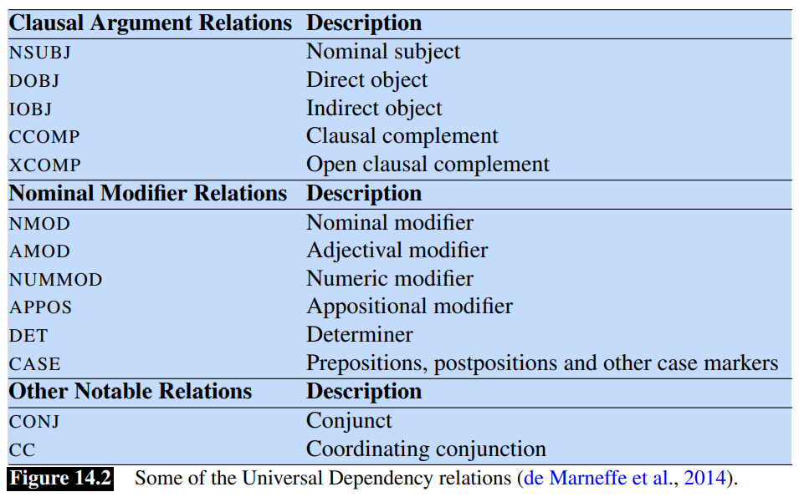
Dependency Parsing
In dependency parsing, various tag represents the relationship between two words in sentences.
Some of the tags are:

Slide 5
Dependency Formalism
A dependency structure can be represented as a directed graph G = (V,A), consisting of a set of vertices V, and a set of ordered pairs of vertices A, which we’ll call arcs.
A dependency tree is a directed graph that satisfies the following constraints:
There is a single designated root node that has no incoming arcs.
With the exception of the root node, each vertex has exactly one incoming arc.
There is a unique path from the root node to each vertex in V.
Notes:
Different grammatical theories or formalisms may place further constraints on these dependency structures. Among the more frequent restrictions are that the structures must be connected, have a designated root node, and be acyclic or planar. Of most relevance to the parsing approaches discussed in this chapter is the common, computationally-motivated, restriction to rooted trees. That is, a dependency tree

Slide 6
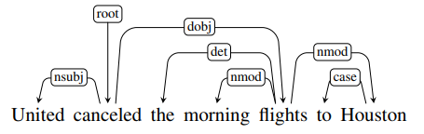
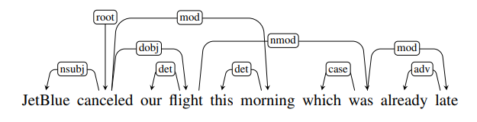
Projectivity
A dependency tree is projective if it can be drawn with no crossing edges.
A projective dependency graph
A Non-projective dependency graph

Slide 7
Projectivity
Projectivity arises from two related issues:
The trees generated from phrase-structure treebanks in such a fashion will always be projective, and hence will be incorrect when non-projective examples like this one are encountered.
There are computational limitations to the most widely used families of parsing algorithms.
Notes:
Our concern with projectivity arises from two related issues. First, the most widely used English dependency treebanks were automatically derived from phrasestructure treebanks through the use of head-finding rules (Chapter 12). The trees generated in such a fashion will always be projective, and hence will be incorrect when non-projective examples like this one are encountered. Second, there are computational limitations to the most widely used families of parsing algorithms. The transition-based approaches discussed in Section 14.4 can only produce projective trees, hence any sentences with non-projective structures will necessarily contain some errors. This limitation is one of the motivations for the more flexible graph-based parsing approach described in Section 14.5

Slide 8
Dependency Treebanks
Dependency-based analysis provides information directly useful in some language processing tasks including information extraction, semantic parsing and question answering.
Dependency treebanks can be created directly by human annotators or via automatic transformation from phrase-structure treebanks.
The translation process from constituent to dependency structures has two subtasks:
Identifying all the head-dependent relations in the structure
Identifying the correct dependency relations for these relations.

Slide 9
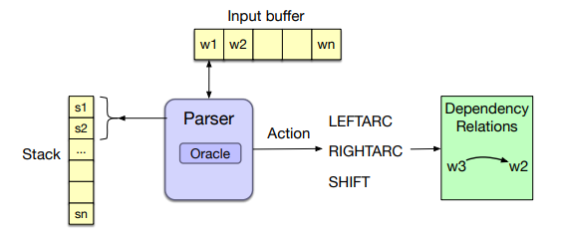
Transition-Based Dependency Parsing
This architecture draws on shift-reduce parsing, a paradigm originally developed for analyzing programming languages.
It uses stack, a buffer of tokens (input buffer) and a predictor.
The predictor is called Oracle. It gives any of the following three commands:
LEFTARC
RIGHTARC
SHIFT
Notes:
LEFTARC: Assert a head-dependent relation between the word at the top of the stack and the second word; remove the second word from the stack.
RIGHTARC: Assert a head-dependent relation between the second word on the stack and the word at the top; remove the top word from the stack;
SHIFT: Remove the word from the front of the input buffer and push it onto the stack.

Slide 10
Transition-Based Dependency Parsing - ORACLE
The oracle for greedily selecting the appropriate transition is trained by supervised machine learning.
Training data
Can be implemented in two ways:
A Featured-based classifiers
A neural classifier

Slide 11
Advanced Methods in Transition-Based Parsing
Alternative Transition Systems
Arc eager transition system is frequently used
Unlike previous method, it has four commands:
LEFTARC
RIGHTARC
SHIFT
REDUCE
The new REDUCE operator removes the top element from the stack.
Beam Search
Beam search uses a breadth-first search strategy with a heuristic filter
At first, applies all the operator to each state
Add each of these new configurations to the frontier until the agenda reaches the limit.
Worst elements are removed in order to add new better configurations
Loop ends when there are non final states only in the agenda.

Slide 12
Graph-Based Dependency Parsing
Advantages over ‘Transition-based’ algorithms:
Better accuracy. Especially on long sentences.
Can work with non-projective dependencies as well
Graph-based algorithms have to solve two problems:
Assigning a score to each edge,
Finding the best parse tree given the scores of all potential edges.
Notes:
Graph-based methods are the second important family of dependency parsing algorithms. Graph-based parsers are more accurate than transition-based parsers, especially on long sentences; transition-based methods have trouble when the heads are very far from the dependents (McDonald and Nivre, 2011).
We have another family of algorithms for creating dependency parse trees i.e ‘Graph-based-systems’ which have some a

Slide 13
Graph-Based Dependency Parsing - Continue
A feature-based algorithm
In a feature-based algorithm we compute the edge score as a weighted sum of features extracted from it
A neural algorithm
State-of-the-art graph-based multilingual parsers are based on neural networks.
Parsing via finding the maximum spanning tree:
a maximum spanning tree of graph emanating from the ROOT is the optimal dependency parse for the sentence.

Slide 14
Evaluation
Classic Accuracy score will not be effective as initially most relations will be marked wrong.
Metrics need to be sensitive enough to provide actual improvement that are being made.
Labeled and Unlabeled Attachment Accuracy
Labeled Attachment Score (LAS): Looks at the proper assignment of a word to its head along with the correct dependency relation.
Unlabeled Attachment Score (UAS): Looks at the correctness of the assigned head, ignoring the dependency relation.
Labeled Accuracy Score (LS): The percentage of tokens with correct labels, ignoring where the relations are coming from.

Slide 15
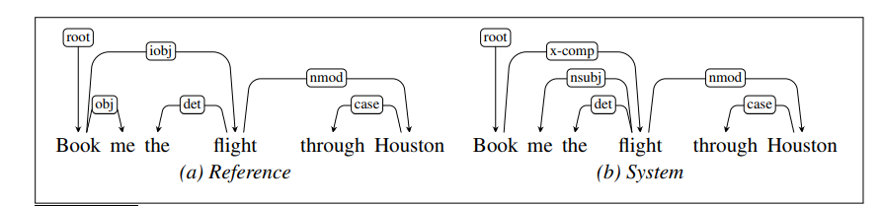
Evaluation - Example of LAS UAS
Here,
LAS = 4/6
UAS = 5/6
Notes:
The system correctly finds 4 of the 6 dependency relations present in the reference parse and receives an LAS of 2/3. However, one of the 2 incorrect relations found by the system holds between book and flight, which are in a head-dependent relation in the reference parse; the system therefore achieves a UAS of 5/6.

Slide 16
Thank you

